Slide 1
FINAL PRESENTATION
UREDU

Slide 2
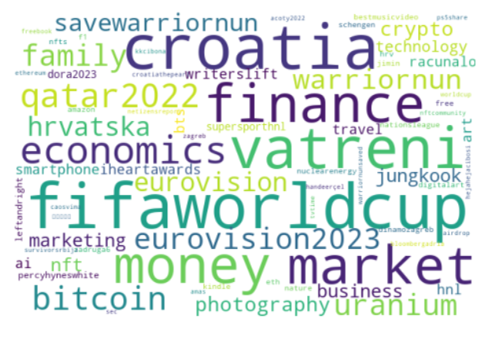
Agenda
Introduction
Architecture & Cost
Analysis & Results
Questions

Slide 3
Introduction
client
Societum News
goal
recognizing social groups on Twitter
discovering their evolving through time
enhance news articles’ reach based on social behavior

Slide 4

Introduction
sources
Twitter database:
tables
users | tweets
user_id, name, friends, followers, location, … | tweet_id, hashtag, created_at, language, …

Slide 5
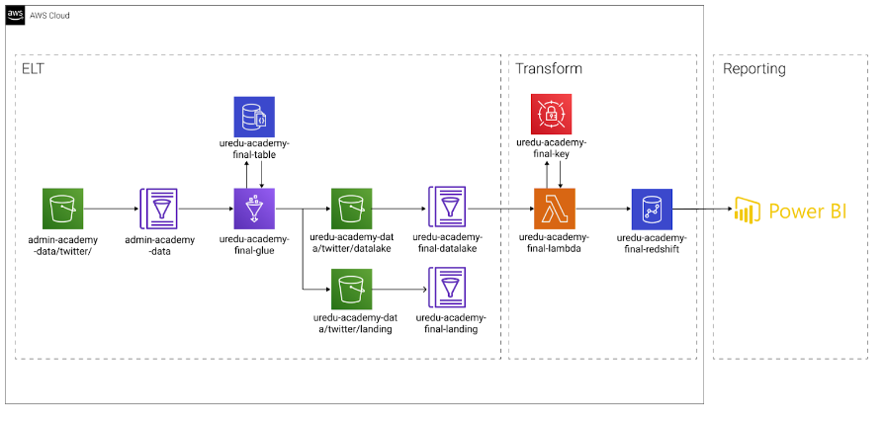
Architecture & Cost
architecture
AWS S3
AWS Glue
AWS DynamoDB
AWS Lambda
AWS Redshift

Slide 6
Architecture & Cost
cost
initial cost |  | realized cost
Total Cost for AWS Services (monthly) |  | Total Cost for AWS Services (monthly)
S3 Standard | 0.06 USD | S3 Standard | 0.03 USD
ETL jobs | 0.46 USD | ETL jobs | 7.34 USD
Redshift | 47.30 USD | Redshift | 47.30 USD
Comprehend | 84.00 USD | DynamoDB Data Storage | 0.03 USD
Translate | 60.00 USD | SQL Queries | 4.35 USD
 |  | Secrets | 0.03 USD
Total cost: 191.82 USD (monthly) |  | Total cost: 59.45 USD (monthly)

Slide 7
Analysis & Results
Tweets through time
Hashtags
Events
Users and social groups
Social groups through time
Tweets for specific social group and time
Conclusions

Slide 8
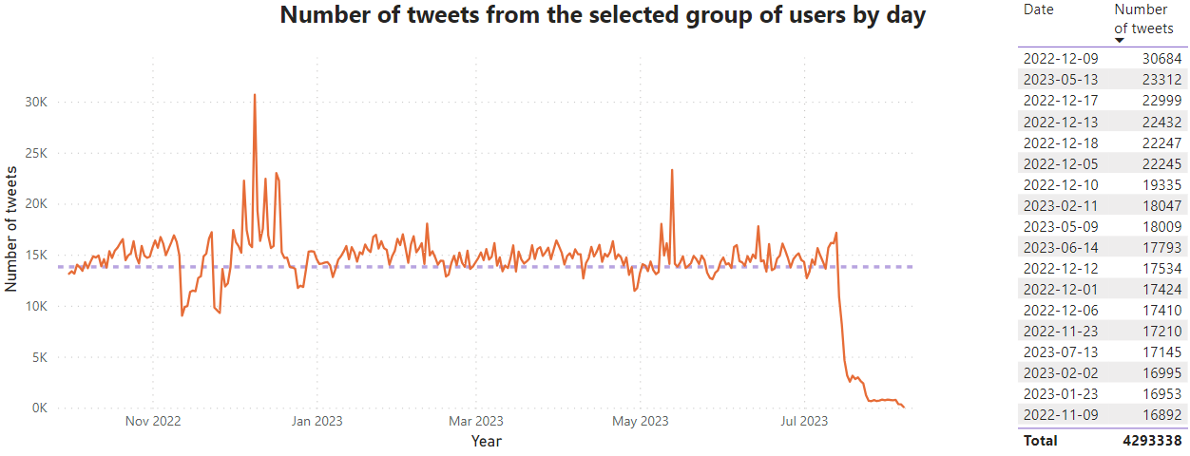
Tweets through time

Slide 9
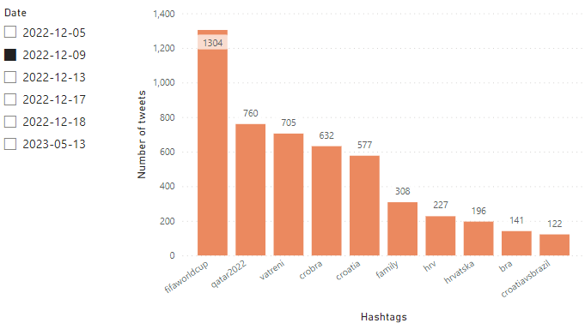
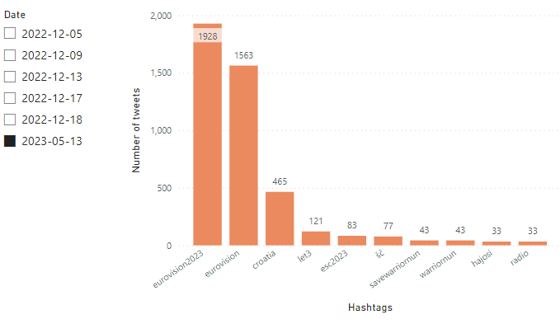
Tweets through time
Croatia vs Brazil: World Cup quarterfinals
Eurovision final

Slide 10
Tweets through time
Specific conclusion:
the two most followed events in the mentioned period are the
2022 World Cup in December and Eurovision in May 2023.

Slide 11
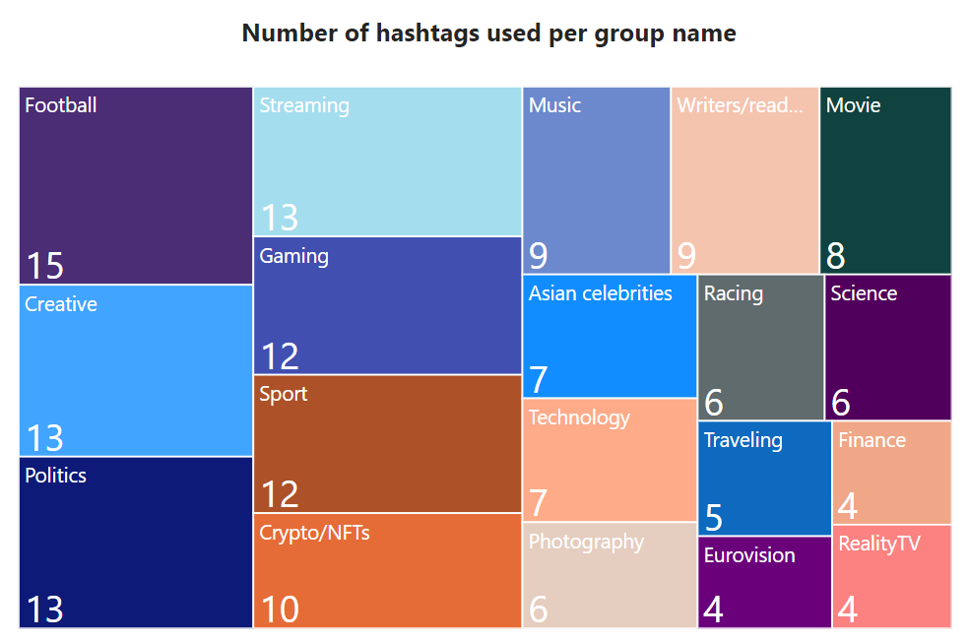
Hashtags
Hashtags
Social groups
(group name)

Slide 12
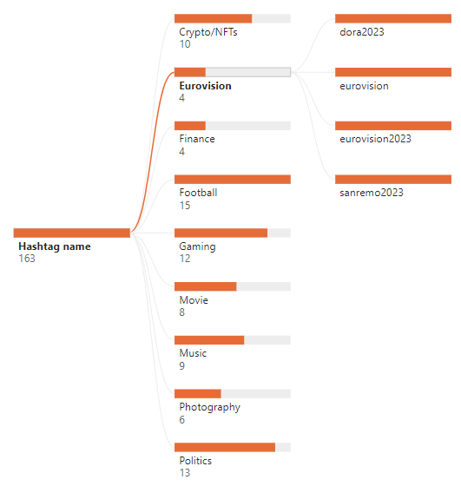
Hashtags
List of hashtags
Can be useful when publishing articles and news

Slide 13
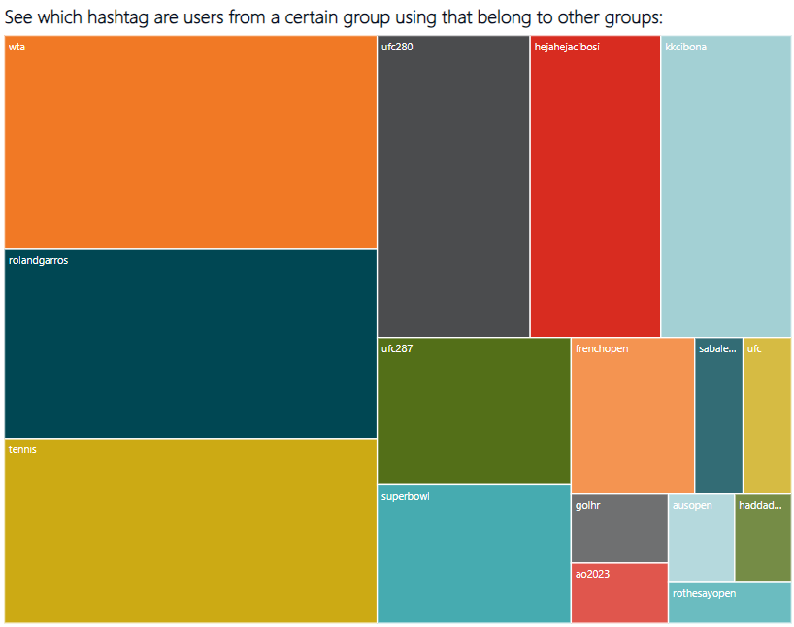
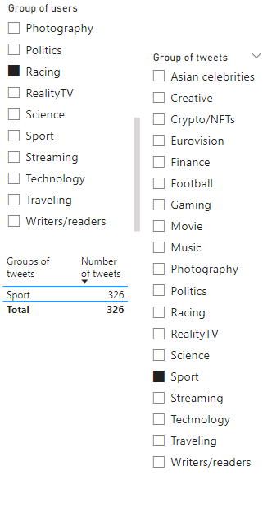
Hashtags
Hashtags not about the group’s usual topics

Slide 14
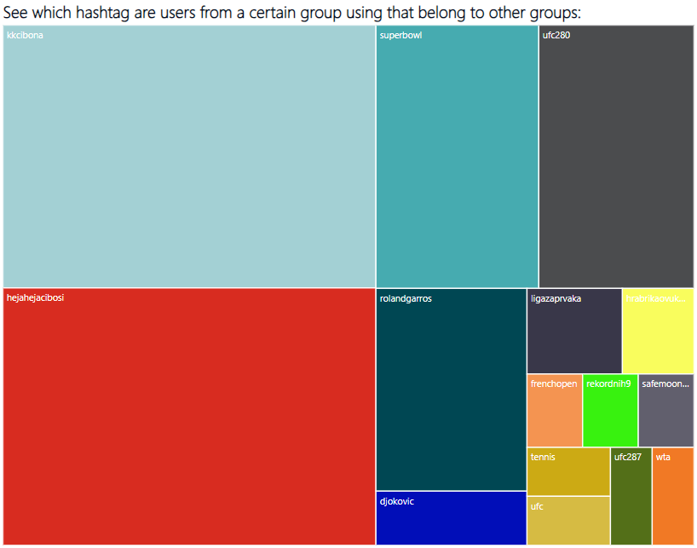
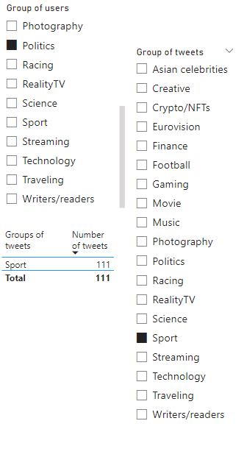
Hashtags
Hashtags not about the group’s usual topics

Slide 15
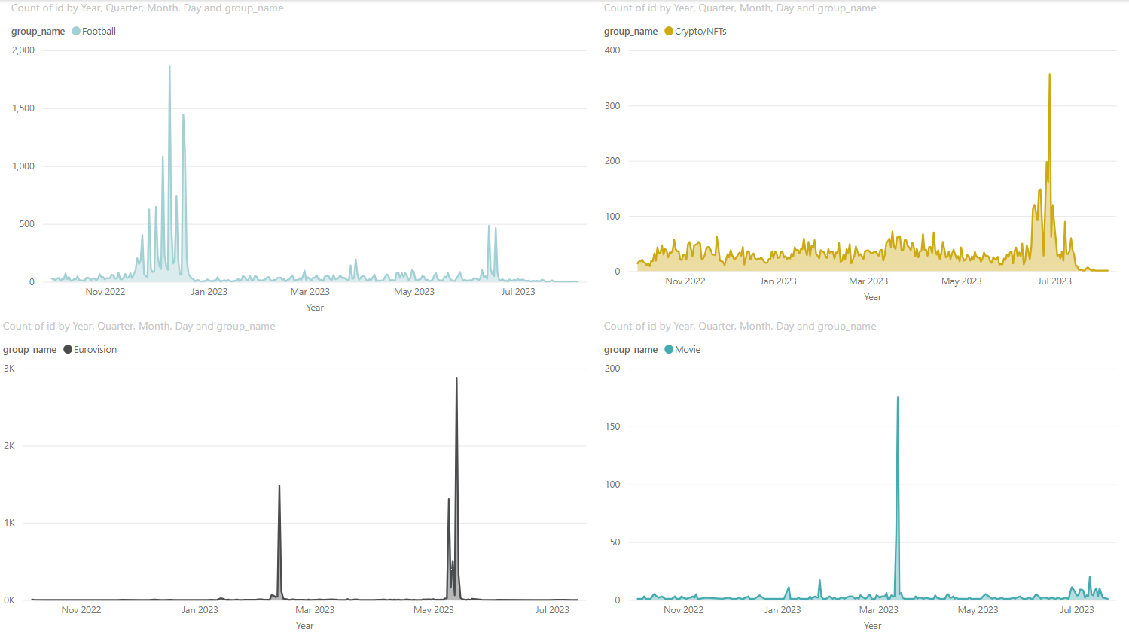
Events
*strategy impact

Slide 16
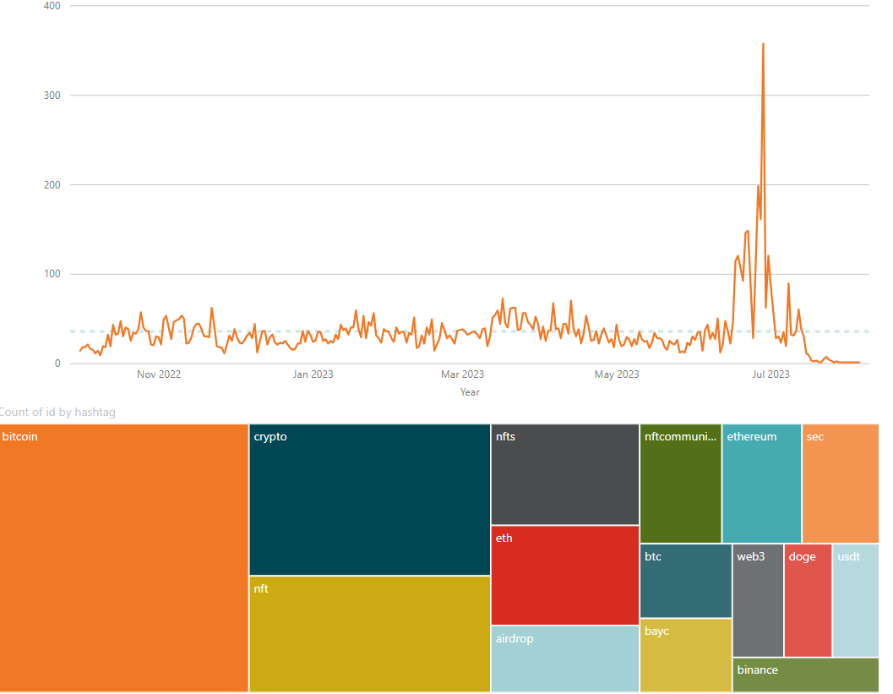
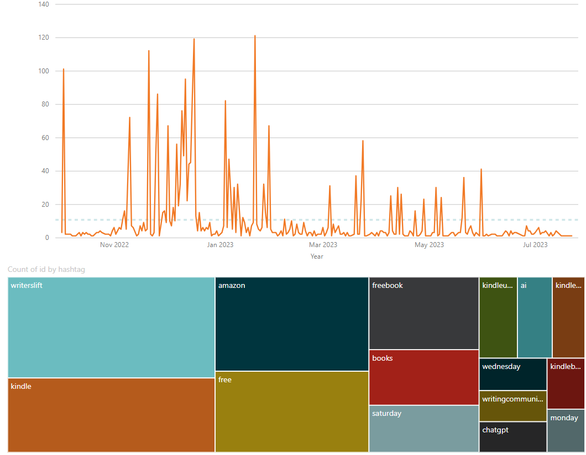
Events
*strategy impact
Mentions of hashtags from Crypto/NFTs group throughout year.
Mentions of hashtags from Writers/readers group throughout year.

Slide 17
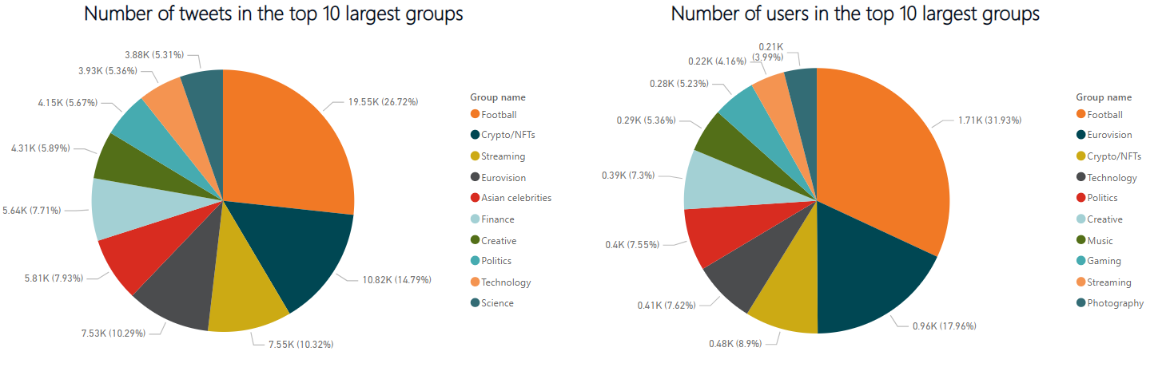
Users and social groups

Slide 18
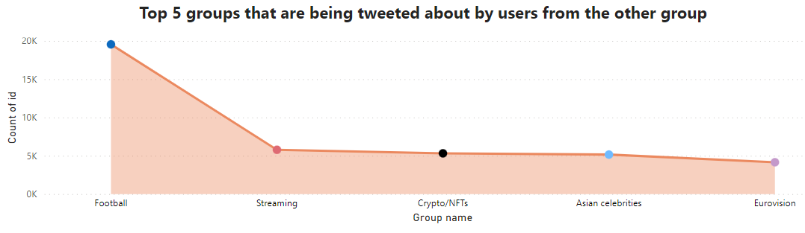
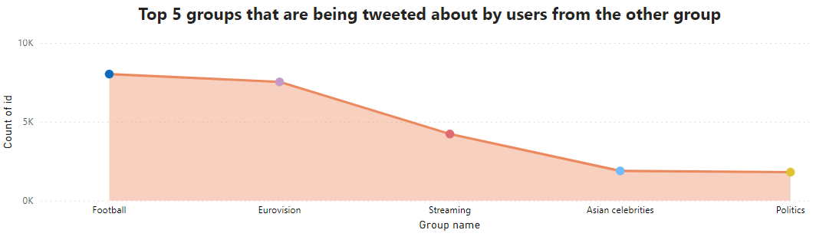
Users and social groups
Group name:
Football
Group name:
Eurovision

Slide 19
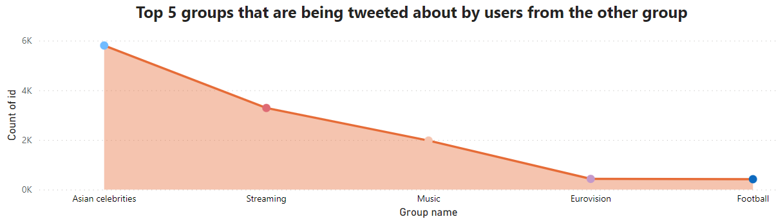
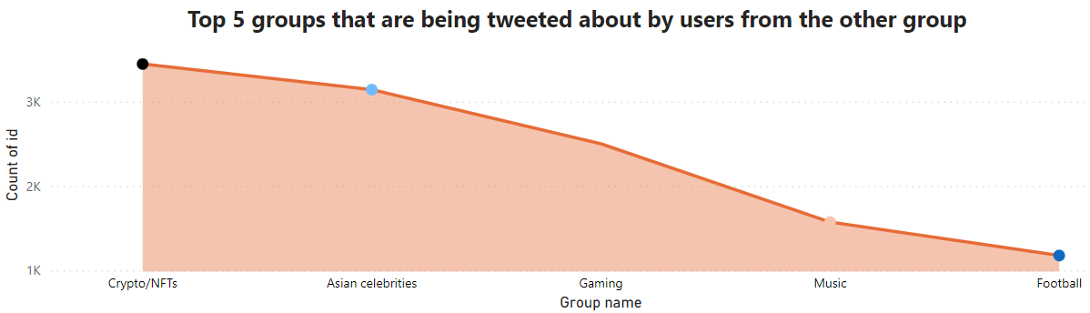
Users and social groups
Group name:
Asian celebrities
Group name:
Gaming

Slide 20
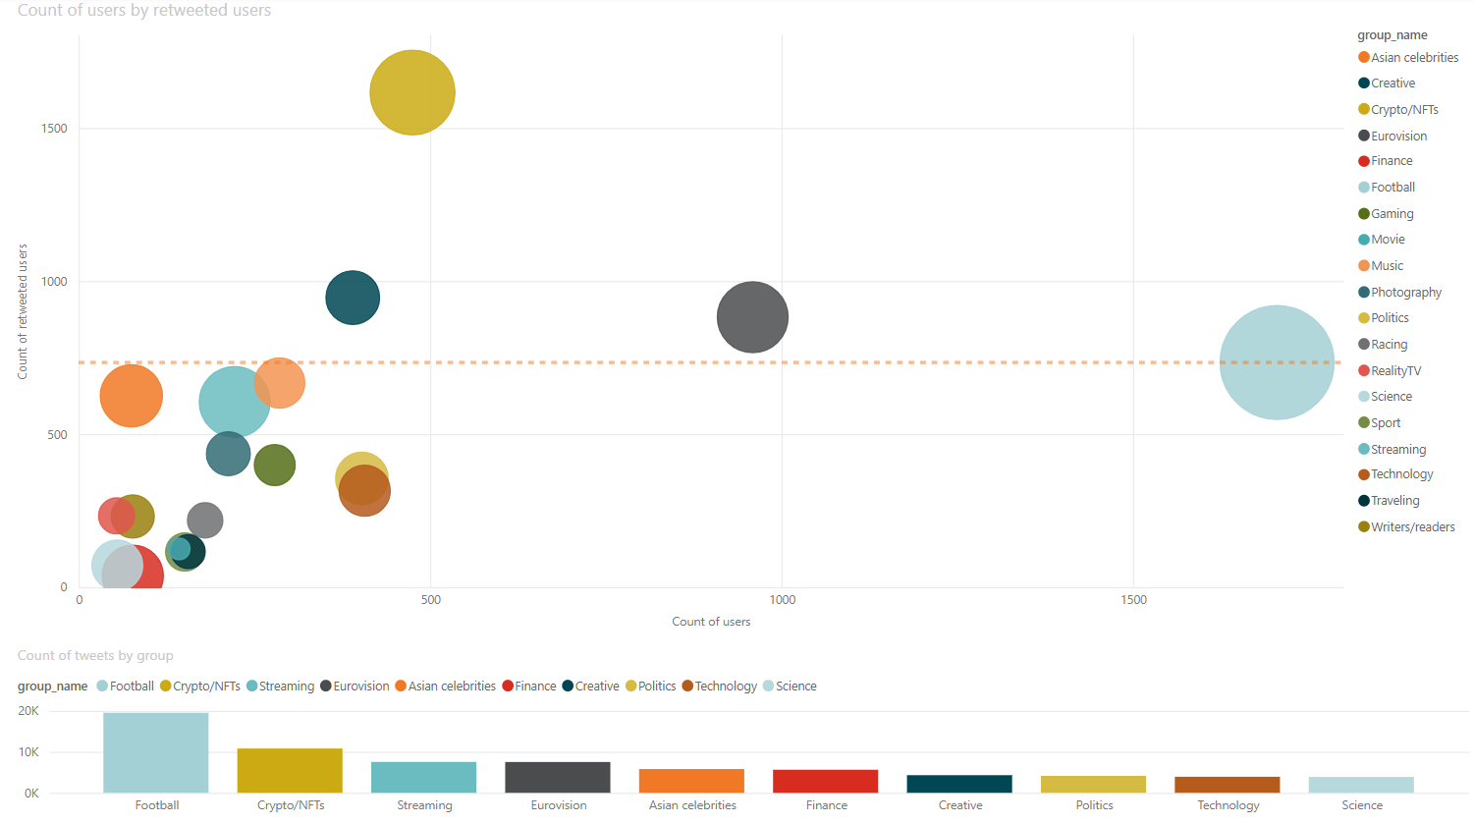
Users and social groups
Which group’s users are most active despite the size of the group?

Slide 21
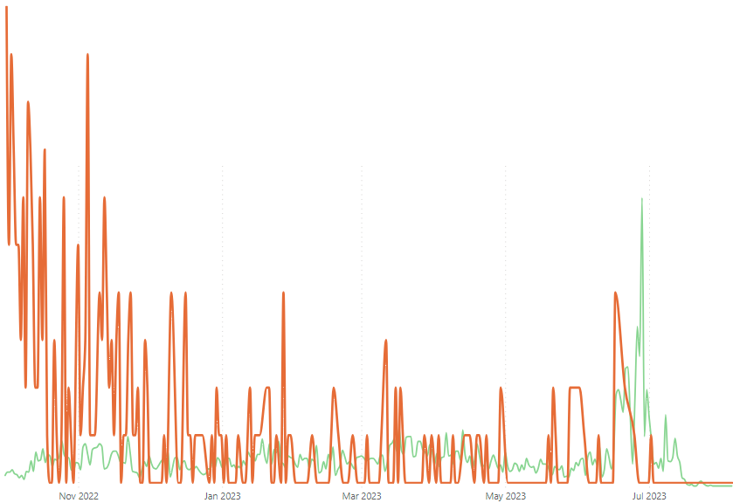
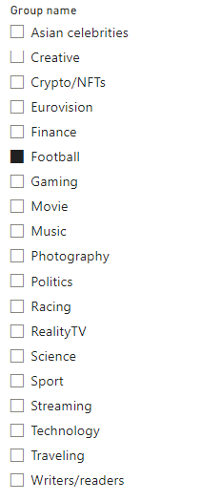
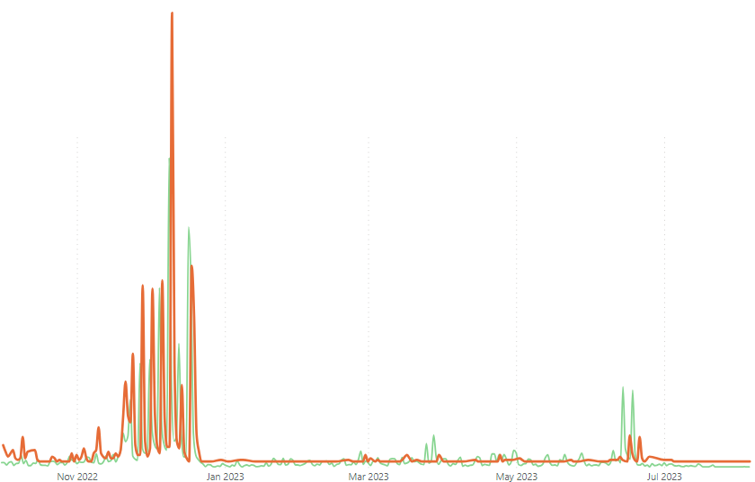
Social groups through time
How do groups evolve through time?
Frequency of joining
Number of tweets

Slide 22
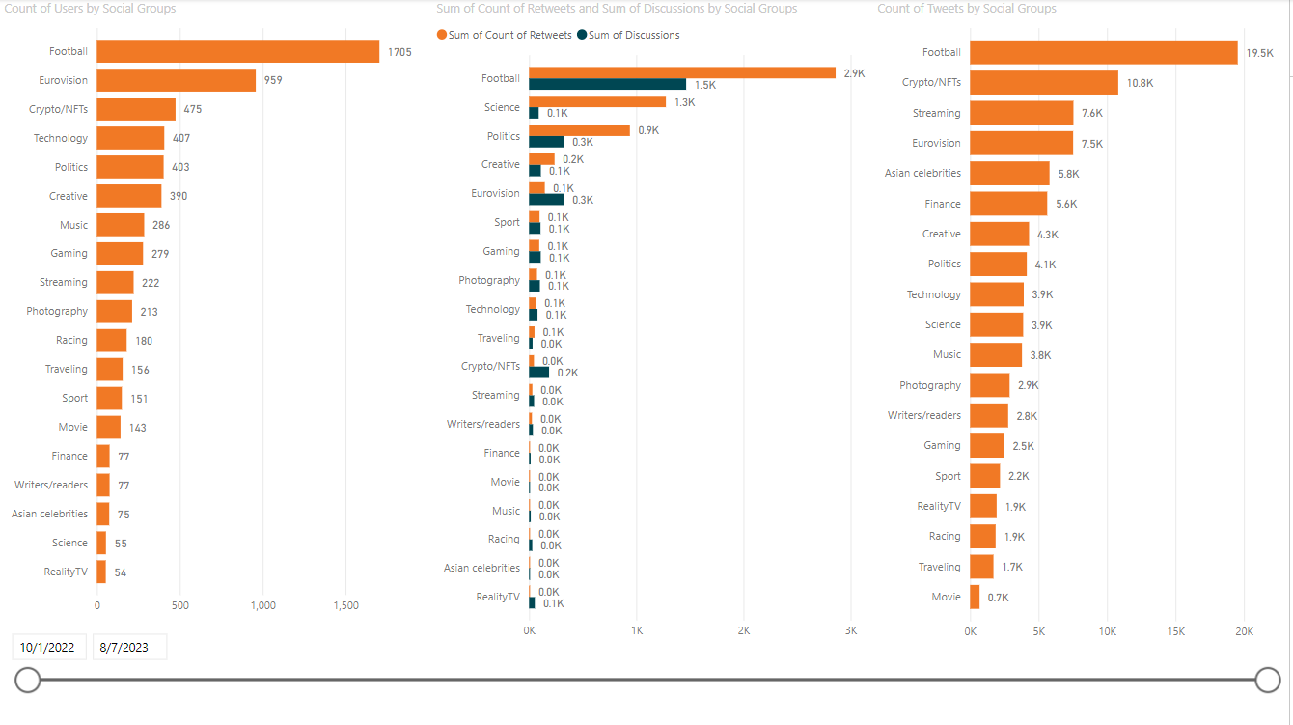
Social groups through time
Number of users in Social groups for a specific time period
Number of retweets and discussions in Social groups for a specific time period
Number of Tweets per Social group for a specific time period

Slide 23
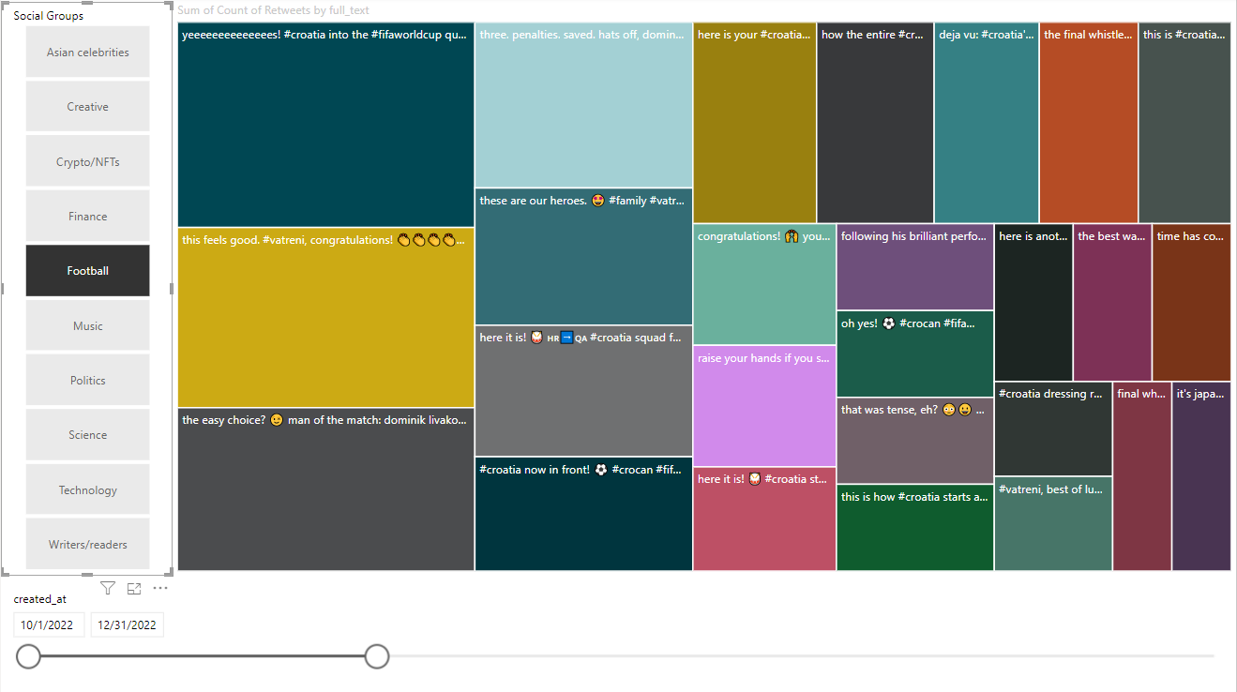
Tweets for specific social group and time
Tweet content per social group and time

Slide 24
Specific conclusions:
Users of initial groups often tweet about other groups in greater numbers than about the initial group
Groups with pronounced discussion have more user activity by tweet like Eurovision, Crypto/NFTs and Reality TV
Interests of users outside their primary group can be utilized for suggestions of the next articles
Events that attract a lot of people are the main factors that affect twitter social groups

Slide 25
General conclusions
time and events have a great influence in social networks and structures
hashtags correspond to social events
social groups are heterogeneous and changeable
observed data conclusions strategy

Slide 26
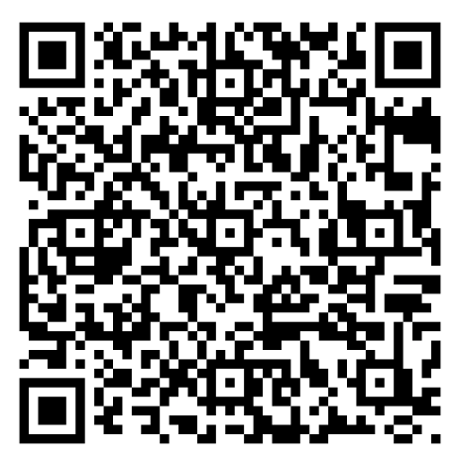
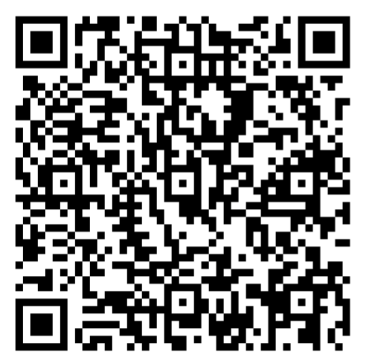
Strategy & Documentation PDFs
Documentation:
https://drive.google.com/file/d/16JEn22mX2DwCUmu1YtPS_A7cNHHAtyMe/view?usp=sharing
Strategy:
https://drive.google.com/file/d/1AavB8SrNdlzpXepI7rvmfRBCbfkj31zo/view?usp=sharing

Slide 27
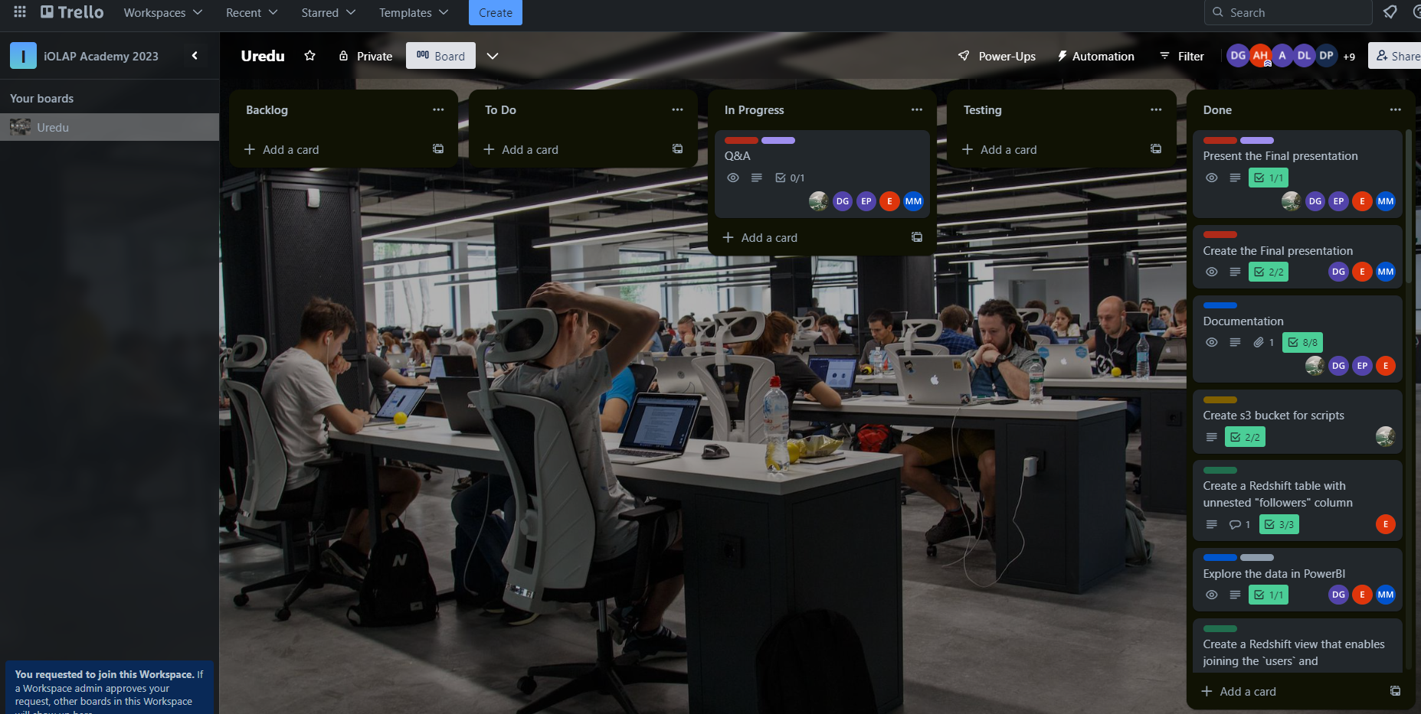
QUESTIONS TIME in progress…

